Slide 1
Data Interpretation

Slide 2
Data Interpretation is one of the easy sections of one day competitive Examinations. It is an extension of Mathematical skill and accuracy. Data interpretation is nothing but drawing conclusions and inferences from a comprehensive data presented numerically in tabular form by means of an illustration, viz. Graphs, Pie Chart etc. Thus the act of organizing and interpreting data to get meaningful information is Data Interpretation.
SOME USEFUL TIPS :
1 . Data Interpretation questions are based on information given in tables and graphs. These questions test your ability to interpret the information presented and to select the appropriate data for answering a question.
2 . Get a general picture of the information before reading the question. Read the given titles carefully and try to understand its nature.
3 . Avoid lengthy calculations generally, data interpretation questions do not require to do extensive calculations and computations. Most questions simply require reading the data correctly and carefully and putting them to use directly with common sense.
4 . Breakdown lengthy questions into smaller parts and eliminate impossible choices.

Slide 3
5 . Use only the information given and your knowledge of everyday facts, such as the number of hours in a day, to answer the questions based on tables and graphs.
6 . Answer the questions asked and not what you think the questions should be.
7 . Be careful while dealing with units.
8 . To make reading easier and to avoid errors observe graphs keeping them straight.
9 . Be prepared to apply basic mathematical rules, principles and formulae. 10. Since one of the major benefits of graphs and tables is that they present data in a form that enables you to readily make comparisons, use this visual attribute of graphs and tables to help you answer the questions. Where possible, use your eyes instead of your computational skills.

Slide 4
TABLES
• Tables are often used in reports, magazines and newspaper to present a set of numerical facts. They enable the reader to make comparisons and to draw quick conclusions. It is one of the easiest and most accurate ways of presenting data. They require much closer reading than graphs of charts and hence are difficult and time consuming to interpret. One of the main purposes of tables is to make complicated information easier to understand. The advantage of presenting data in a table is that one can see the information at a glance. While answering questions based on tables, carefully read the table title and the column headings. The title of the table gives you a general idea of the type and often the purpose of the information presented. The column headings tell you the specific kind of information given in that column. Both the table title and the column headings are usually very straight forward.

Slide 5
GRAPHS
There may be four types of graphs:
1) Circle Graphs: Circle graphs are used to show how various sectors are in the whole. Circle graphs are sometimes called Pie Charts. Circle graphs usually give the percent that each sector receives In such representation the total quantity in question is distributed over a total angle of 360°. While using circle graphs to find ratios of various sectors, don't find the amounts each sector received and then the ratio of the amounts. Find the ratio of the percentages, which is much quicker.
2)Line Graphs: Line graphs are used to show how a quantity changes continuously. If the line goes up, the quantity is increasing; if the line goes down, the quantity is decreasing; if the line is horizontal, the quantity is not changing.
3) Bar Graphs: Given quantities can be compared by the height or length of a bar graph. A bar graph can have either vertical or horizontal bars. You can compare different quantities or the same quantity at different times. In bar graph the data is discrete. Presentation of data in this form makes evaluation of parameters comparatively very easy.

Slide 6
4) Cumulative Graphs : You can compare several categories by a graph of the cumulative type. These are usually bar or line graphs where the height of the bar or line is divided up proportionally among different quantities.
CONCEPT TO REVISE:
Average = Sum of observations/Total number of observations
Percentage Increase = (Increase/Original Value)*100
Percentage Decrease = (Decrease/Original Value)*100
where, Original Value is the value to which increase and decrease has been done or the old value

Slide 7
DIRECTIONS for questions 1-5: The following data gives year – wise outlay in lakhs of rupees in a certain 5-year plan (1980 - 85) of a state.
Study the below table carefully and answer the following questions:
Years | Transport & communication | Education | Housing | Health | Social Welfare
1980-81 | 56219 | 75493 | 13537 | 9596 | 1985
1981-82 | 71416 | 80691 | 15902 | 10135 | 2073
1982-83 | 73520 | 61218 | 16736 | 11000 | 3918
1983-84 | 75104 | 73117 | 17523 | 12038 | 4102
1984-85 | 80216 | 90376 | 19420 | 15946 | 10523

Slide 8
1. Which year saw the maximum expenditure on Health, so far, out of the years given?
A. 1984 – 85
B. 1980 – 81
C. 1981 – 82
D. 1982 – 83
2. Number of times, the outlay on Transport & communication was increased over preceding year was
A. 3 times
B. 7 times
C. 5 times
D. 4 times

Slide 9
3. What was the percentage increase during 1982-83 over 1981-82 in Social Welfare outlay?
A. 88.43%
B. 90.13%
C. 92.43%
D. 89.00%
4. What was the average total outlay on Housing during the plan period?
A. Rs. 16623.6lakhs
B. Rs. 22601lakh
C. Rs. 20600lakhs
D. None of these

Slide 10
5. What is the approx ratio between outlays on Education and Health during 1982-83?
A. 556:100
B. 213:100
C. 431:100
D. 513:100

Slide 11
DIRECTIONS for questions 6-10: Study the following data table carefully and answer the questions given below:
Number of workers Working at Various Departments of Bharat Petroleum
Year | Exploration Department | Health Department | Maintenance Department | Safety and Environment Department | Finance Department
2003 | 150 | 25 | 50 | 45 | 75
2004 | 225 | 40 | 45 | 62 | 70
2005 | 450 | 65 | 30 | 90 | 73
2006 | 470 | 73 | 32 | 105 | 70
2007 | 500 | 80 | 35 | 132 | 74
2008 | 505 | 75 | 36 | 130 | 75

Slide 12
6. Which year had the total number of workers equal to the total number of workers the factory had in the year 2007?
A. 2008
B. 2003
C. 2006
D. 2005
7. Which department had the total employees equal to 228 during the years 2003 to 2008?
A. Exploration
B. Health
C. Maintenance
D. Safety and Environment

Slide 13
8. Which year had the number of workers working in Finance department more than 20% of the total workers?
A. 2003
B. 2006
C. 2005
D. 2007
9. What was the ratio of workers working in Health department in 2004 to employees working in Safety and Environment department in 2007?
A. 10:33
B. 12:25
C. 7:33
D. 10:37
10. What was the average number of workers working in exploration department during the years 2003 to 2008?
A. 390
B. 383
C. 370
D. 400

Slide 14
Direction: Study the following table carefully and answer the questions based on it.
Number of students (in thousand) placed in five different companies during six different years
Year | Company
 | Accenture | Google | Yahoo | Tata | Flipkart
2010 | 9.6 | 10.4 | 9.3 | 9.8 | 8.7
2011 | 10.4 | 12.6 | 7.2 | 13.8 | 6.2
2012 | 12.6 | 9.8 | 10.4 | 14.9 | 9.8
2013 | 16.8 | 15.4 | 11.4 | 16.3 | 11.3
2014 | 19.3 | 13.4 | 13.4 | 11.8 | 7.8
2015 | 18.7 | 16.7 | 12.7 | 15.7 | 13.7

Slide 15
1. What was the ratio of the number of students placed in Accenture in the year 2013 to that of those placed in Tata in the year 2011?
A. 28 : 23
B. 81 : 67
C. 85 : 69
D. 25 : 23E. None of these
2. The number of students placed in Yahoo in the year 2013 was approximately what per cent of the total number of students placed in Flipkart in the year 2011, 2012 and 2014 together?
A. 43%
B. 55%
C. 48%
D. 57%
E. 51%

Slide 16
3. What was the average number of students placed in all the companies together in the year 2012?
A. 11600
B. 11500
C. 11200
D. 12300
E. 10900
4. In which company was the number of students placed in the year 2013 the highest?
A. Accenture
B. Flipkart
C. Tata
D. Google
E. Yahoo

Slide 17
5. In which company did the number of placement continuously increase during all the years?
A. Accenture
B. Tata
C. Google
D. Flipkart
E. None of these

Slide 18
PIE CHART
(CIRCULAR GRAPH)

Slide 19
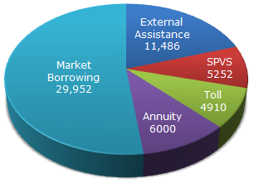
The following pie-chart shows the sources of funds to be collected by the National Highways Authority of India (NHAI) for its Phase II projects. Study the pie-chart and answers the question that follow.
Sources of funds to be arranged by NHAI for Phase II projects (in crores Rs.)

Slide 20
1. Near about 20% of the funds are to be arranged through:
SPVS
External Assistance
Annuity
Market Borrowing
2. If NHAI could receive a total of Rs. 9695 crores as External Assistance, by what percent (approximately) should it increase the Market Borrowing to arrange for the shortage of funds?
4.5%
7.5%
6%
8%

Slide 21
3. If the toll is to be collected through an outsourced agency by allowing a maximum 10% commission, how much amount should be permitted to be collected by the outsourced agency, so that the project is supported with Rs. 4910 crores?
Rs. 6213 crores
Rs. 5827 crores
Rs. 5401 crores
Rs. 5316 crores
4. The central angle corresponding to Market Borrowing is
52°
137.8°
187.2°
192.4°

Slide 22
5. The approximate ratio of the funds to be arranged through Toll and that through Market Borrowing is
2 : 9
1 : 6
3 : 11
2 : 5

Slide 23
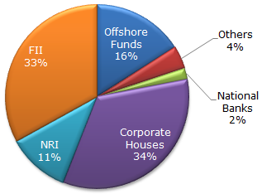
The following pie chart shows the amount of subscriptions generated for India Bonds from different categories of investors.
Subscriptions Generated for India Bonds

Slide 24
1. In the corporate sector, approximately how many degrees should be there in the central angle ?
120°
121°
122°
123°
2. If the investment by NRI's are Rs 4,000 crore, then the investments by corporate houses and FII's together is:
24,000 crore
24,363 crore
25,423 crore
25,643 crore

Slide 25
3. What percentage of the total investment is coming from FII's and NRI's ?
33 %
11 %
44 %
22 %
4. If the total investment other than by FII and corporate houses is Rs 335,000 crore, then the investment by NRI's and Offshore funds will be (approximately) ?
274,100
285,600
293,000
Cannot be determined

Slide 26
5. If the total investment flows from FII's were to be doubled in the next year and the investment flows from all other sources had remained constant at their existing levels for this year, then what would be the proportion of FII investment in the total investment into India Bonds next year (in US $ millions) ?
40 %
50 %
60 %
70 %

Slide 27
BAR GRAPH

Slide 28
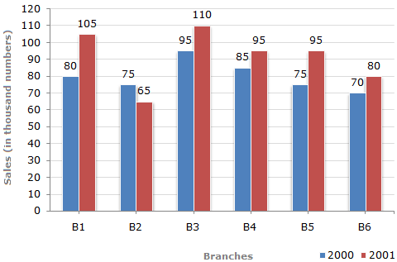
The bar graph given below shows the sales of books (in thousand number) from six branches of a publishing company during two consecutive years 2000 and 2001.
Sales of Books (in thousand numbers) from Six Branches - B1, B2, B3, B4, B5 and B6 of a publishing Company in 2000 and 2001.

Slide 29
1. What is the ratio of the total sales of branch B2 for both years to the total sales of branch B4 for both years?
2:3
3:5
4:5
7:9
2.Total sales of branch B6 for both the years is what percent of the total sales of branches B3 for both the years?
68.54%
71.11%
73.17%
75.55%

Slide 30
3. What percent of the average sales of branches B1, B2 and B3 in 2001 is the average sales of branches B1, B3 and B6 in 2000?
75%
77.5%
82.5%
87.5%
4.What is the average sales of all the branches (in thousand numbers) for the year 2000?
73
80
83
88

Slide 31
5. Total sales of branches B1, B3 and B5 together for both the years (in thousand numbers) is?
250
310
435
560

Slide 32
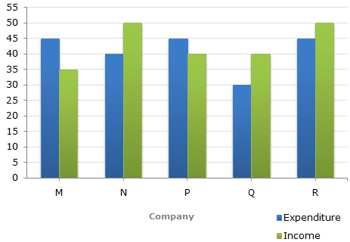
The following bar graph shows the Income and Expenditures (in million US $) of five companies in the year 2001. The percent profit or loss of a company is given by
% Profit/Loss = Income – Expenditure x 100
Expenditure
Income and Expenditure (in million US $) of five companies in the year 2001.

Slide 33
1. The companies M and N together had a percentage of profit/loss of?
12% loss
10% loss
10% profit
There was no loss or profit
2. In 2001, what was the approximate percentage of profit/loss of all the five Companies taken together?
5% profit
6.5% profit
4% loss
7% loss

Slide 34
3. Which company earned the maximum percentage profit in the year 2001?
M
N
P
Q
4. For Company R, if the expenditure had increased by 20% in year 2001 from year 2000 and the company had earned profit of 10% in 2000, what was the Company's income in 2000 (in million US $)?
35.75
37.25
38.5
41.25

Slide 35
5. If the income of Company Q in 2001 was 10% more than its income in 2000 and the Company had earned a profit of 20% in 2000, then its expenditure in 2000 (in million US $) was?
28.28
30.30
32.32
34.34

Slide 36
LINE GRAPH

Slide 37
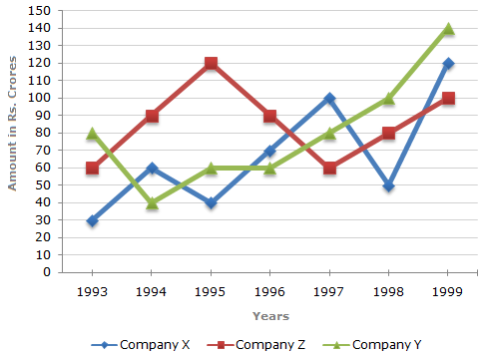
Study the following line graph and answer the questions.
Exports from Three Companies Over the Years (in Rs. crore)

Slide 38
1. For which of the following pairs of years the total exports from the three Companies together are equal?
1995 and 1998
1996 and 1998
1997 and 1998
1995 and 1996
2. Average annual exports during the given period for Company Y is approximately what percent of the average annual exports for Company Z?
87.12%
89.64%
91.21%
93.33%

Slide 39
3. In which year was the difference between the exports from Companies X and Y the minimum?
1994
1995
1996
1997
4. What was the difference between the average exports of the three Companies in 1993 and the average exports in 1998?
Rs. 15.33 crores
Rs. 18.67 crores
Rs. 20 crores
Rs. 22.17 crores

Slide 40
5. In how many of the given years, were the exports from Company Z more than the average annual exports over the given years?
2
3
4
5

Slide 41
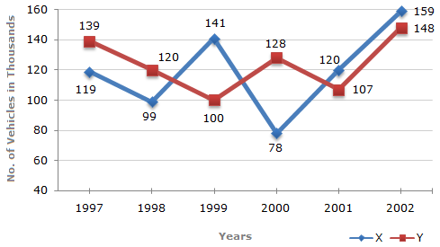
Study the following line graph and answer the questions based on it.
Number of Vehicles Manufactured by Two companies ove the Years (Number in Thousands)

Slide 42
1. What is the difference between the number of vehicles manufactured by Company Y in 2000 and 2001 ?
50000
42000
33000
21000
2. What is the difference between the total productions of the two Companies in the given years ?
19000
22000
26000
28000

Slide 43
3. What is the average numbers of vehicles manufactured by Company X over the given period ? (rounded off to nearest integer)
119333
113666
112778
111223
4. In which of the following years, the difference between the productions of Companies X and Y was the maximum among the given years ?
1997
1998
1999
2000

Slide 44
5. The production of Company Y in 2000 was approximately what percent of the production of Company X in the same year ?
173
164
132
97

Slide 45
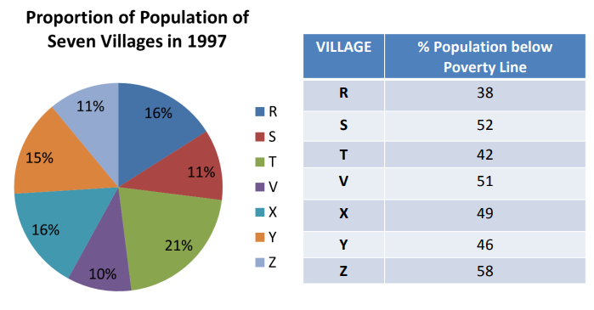
Study the following pie-chart and the table and answer the questions based on them.

Slide 46
If the population of village R in 1997 is 32000, then what will be the population of village Y below poverty line in that year?
14100
15600
16500
17000
Ans: B
The ratio of population of village T below poverty line to that of village Z below poverty line in 1997 is:
11 : 23
13 : 11
23 : 11
11 : 13
Ans: C

Slide 47
Find the population of village S if the population of village X below poverty line in 1997 is 12160.
18500
20500
22000
26000
Ans: C
If in 1998, the population of villages Y and V increase by 10% each and the percentage of population below poverty line remains unchanged for all the villages, then find the population of village V below poverty line in 1998, given that the population of village Y in 1997 was 30000.
11250
12760
13140
13780
Ans: B

Slide 48


